Slide 1
Chapter 4 Linear Models for Classification
4.1 Introduction
4.2 Linear Regression
4.3 Linear Discriminant Analysis
4.4 Logistic Regression
4.5 Separating Hyperplanes

Slide 2



4.1 Introduction
The discriminant function for the kth indicator response variable
The boundary between class k and l
Linear boundary: an affine set or hyper plane

Slide 3

4.1 Introduction
线性边界的条件:
“Actually, all we require is that some monotone transformation of or Pr(G = k|X = x) be linear for the decision boundaries to be linear.” (?)
推广
函数变换，投影变换……

Slide 4


4.2 Linear Regression of an Indicator Matrix
Indicator response matrix
Predictor
Linear regression model
将分类问题视为回归问题，线性判别函数

Slide 5


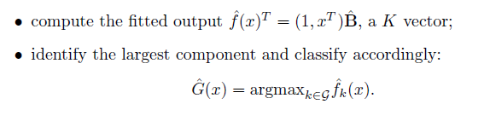
4.2 Linear Regression of an Indicator Matrix
Parameter estimation
Prediction

Slide 6
4.2 Linear Regression of an Indicator Matrix
合理性(?)
Rationale: an estimate of conditional probability (?)
线性函数无界(Does this matter?)

Slide 7

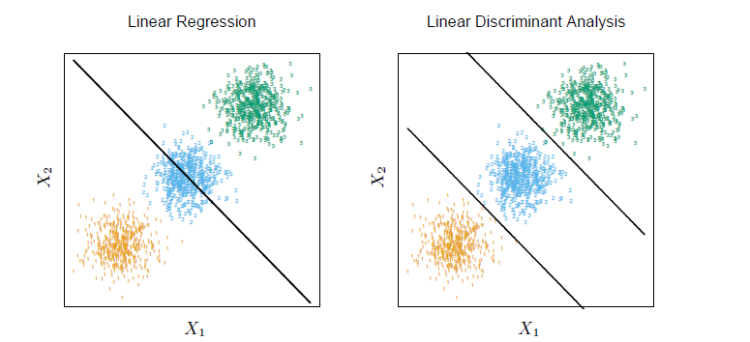
4.2 Linear Regression of an Indicator Matrix
合理性(?)
Masking problem

Slide 8



4.3 Linear Discriminant Analysis
应用多元统计分析：判别分析
Log-ratio：
Prior probability distribution
Assumption: each class density as multivariate Gaussian

Slide 9

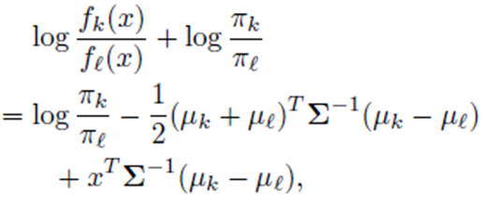
4.3 Linear Discriminant Analysis (LDA)
Additional assumption: classes have a common covariance matrix
Log-ratio:
可以看出，类别之间的边界关于x是线性函数

Slide 10

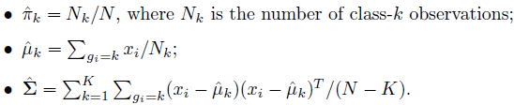

4.3 Linear Discriminant Analysis (LDA)
Linear discriminant function
Estimation
Prediction
G(x) =

Slide 11
4.3 Linear Discriminant Analysis (QDA)
covariance matrices are not assumed to be equal, we then get quadratic discriminant functions(QDA)
The decision boundary between each pair of classes k and l is described by a quadratic equation.

Slide 12


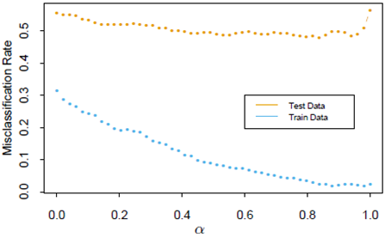
4.3.1 Regularized Discriminant Analysis
A compromise between LDA and QDA
In practice α can be chosen based on the performance of the model on validation data, or by cross-validation.

Slide 13




4.3.2 Computations for LDA
Computations are simplified by diagonalizing
or
Eigen-decomposition

Slide 14

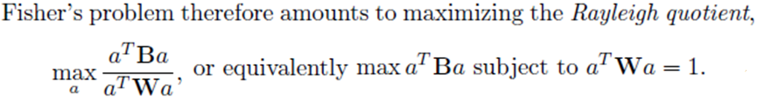
4.3.3 Reduced rank Linear Discriminant Analysis
应用多元统计分析：fisher判别
数据降维与基本思想：
“Find the linear combination such that the between class variance is maximized relative to the within-class variance.”
W is the within-class covariance matrix, and B stands for the between-class covariance matrix.

Slide 15
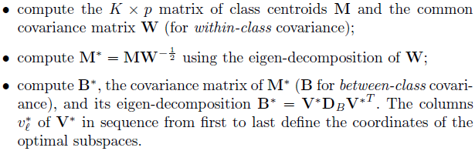
4.3.3 Reduced rank Linear Discriminant Analysis
Steps

Slide 16
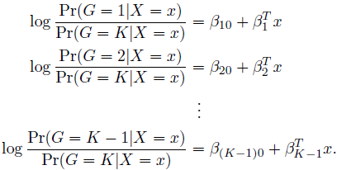
4.4 Logistic Regression
The posterior probabilities of the K classes via linear functions in x.

Slide 17
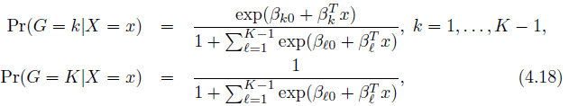
4.4 Logistic Regression
定义合理性，发生比分母选择不影响模型
归一化，得到后验概率

Slide 18
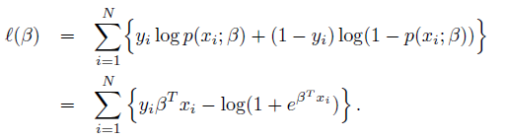

4.4.1 Fitting Logistic Regression Models
Maximum likelihood estimation
log-likelihood (two-class case)
Setting its derivatives to zero

Slide 19


4.4.1 Fitting Logistic Regression Models
Newton-Raphson algorithm

Slide 20


4.4.1 Fitting Logistic Regression Models
matrix notation (two-class case)
y –the vector of values
X –the matrix of values
p –the vector of fitted probabilities with ith element
W –the NN diagonal matrix of weights with ith diagonal element

Slide 21
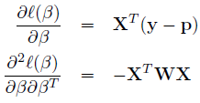


4.4.1 Fitting Logistic Regression Models
matrix notation (two-class case)

Slide 22



4.4.2 Example: South African Heart Disease
实际应用中，还要关心模型（预测变量）选择的问题
Z scores--coefficients divided by their standard errors
大样本定理
则 的MLE 近似服从(多维)标准正态分布，且

Slide 23
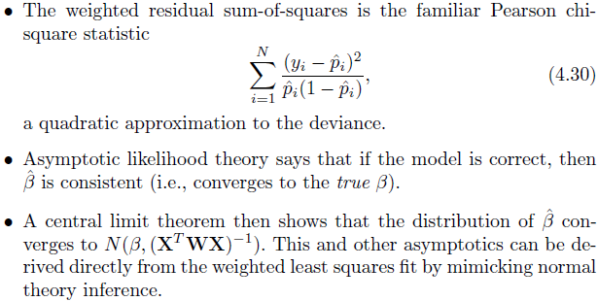
4.4.3 Quadratic Approximations and Inference
Logistic回归的性质

Slide 24


4.4.4 L1 Regularized Logistic Regression
penalty
Algorithm -- nonlinear programming methods(?)
Path algorithms -- piecewise smooth rather than linear

Slide 25

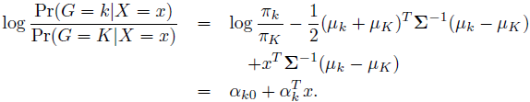
4.4.5 Logistic Regression or LDA?
Comparison （不同在哪里？）
Logistic Regression
VS
LDA

Slide 26
4.4.5 Logistic Regression or LDA?
“The difference lies in the way the linear coefficients are estimated.”
Different assumptions lead to different methods.
LDA– Modification of MLE(maximizing the full likelihood)
Logistic regression – maximizing the conditional likelihood

Slide 27
4.5 Separating Hyperplanes
To construct linear decision boundaries that separate the data into different classes as well as possible.
Perceptrons-- Classifiers that compute a linear combination of the input features and return the sign. (Only effective in two-class case?)
Properties of linear algebra (omitted)

Slide 28


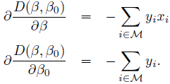

4.5.1 Rosenblatt's Perceptron Learning Algorithm
Perceptron learning algorithm
Minimize
表示被错分类的样品组成的集合
Stochastic gradient descent method
is the learning rate

Slide 29
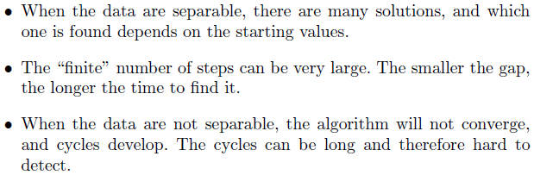
4.5.1 Rosenblatt's Perceptron Learning Algorithm
Convergence
If the classes are linearly separable, the algorithm converges to a separating hyperplane in a finite number of steps.
Problems

Slide 30


4.5.2 Optimal Separating Hyperplanes
Optimal separating hyperplane
maximize the distance to the closest point from either class
By doing some calculation, the criterion can be rewritten as

Slide 31


4.5.2 Optimal Separating Hyperplanes
The Lagrange function
Karush-Kuhn-Tucker (KKT)conditions
怎么解？

Slide 32


4.5.2 Optimal Separating Hyperplanes
Support points
由此可得
事实上，参数估计值只由几个支撑点决定

Slide 33
4.5.2 Optimal Separating Hyperplanes
Some discussion
Separating Hyperplane vs LDA
Separating Hyperplane vs Logistic Regression
When the data are not separable, there will be no feasible solution to this problem→SVM

Slide 34
谢谢大家 !

